Slide 1
Credit Card Approval Prediction using Machine Learning
© Templateswise.com

Slide 2
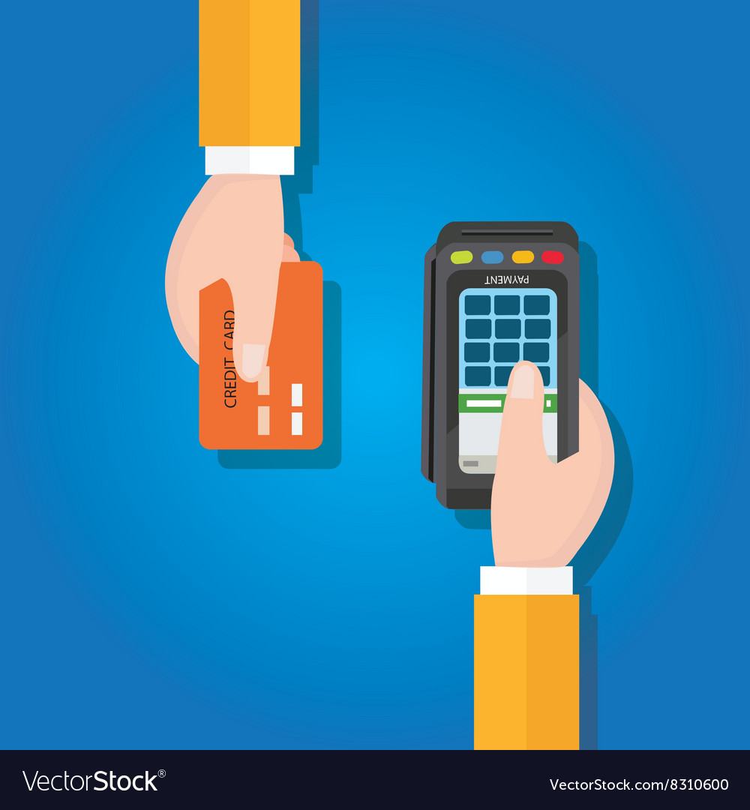
Introduction
Global credit card market value $447bn.
Ease of Access – Tap & Go, Reward points
Potential Revenue: Interest & Annual charges
Massive applications expected in next 5 years
No human intervention needed, thus MACHINE LEARNING!

Slide 3
Methodology
CRISP-DM
Dataset
Business Objective
Research

Slide 4
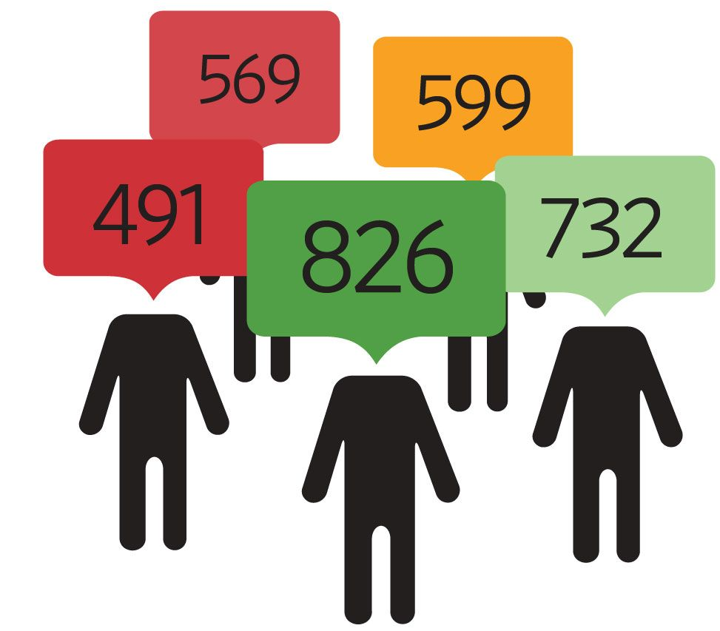
Target Variable
Credit History
Payment behaviour
Length of Credit History
Credit Score
Credit Status
Good > 600
Bad < 600
Aggregating Credit points

Slide 5
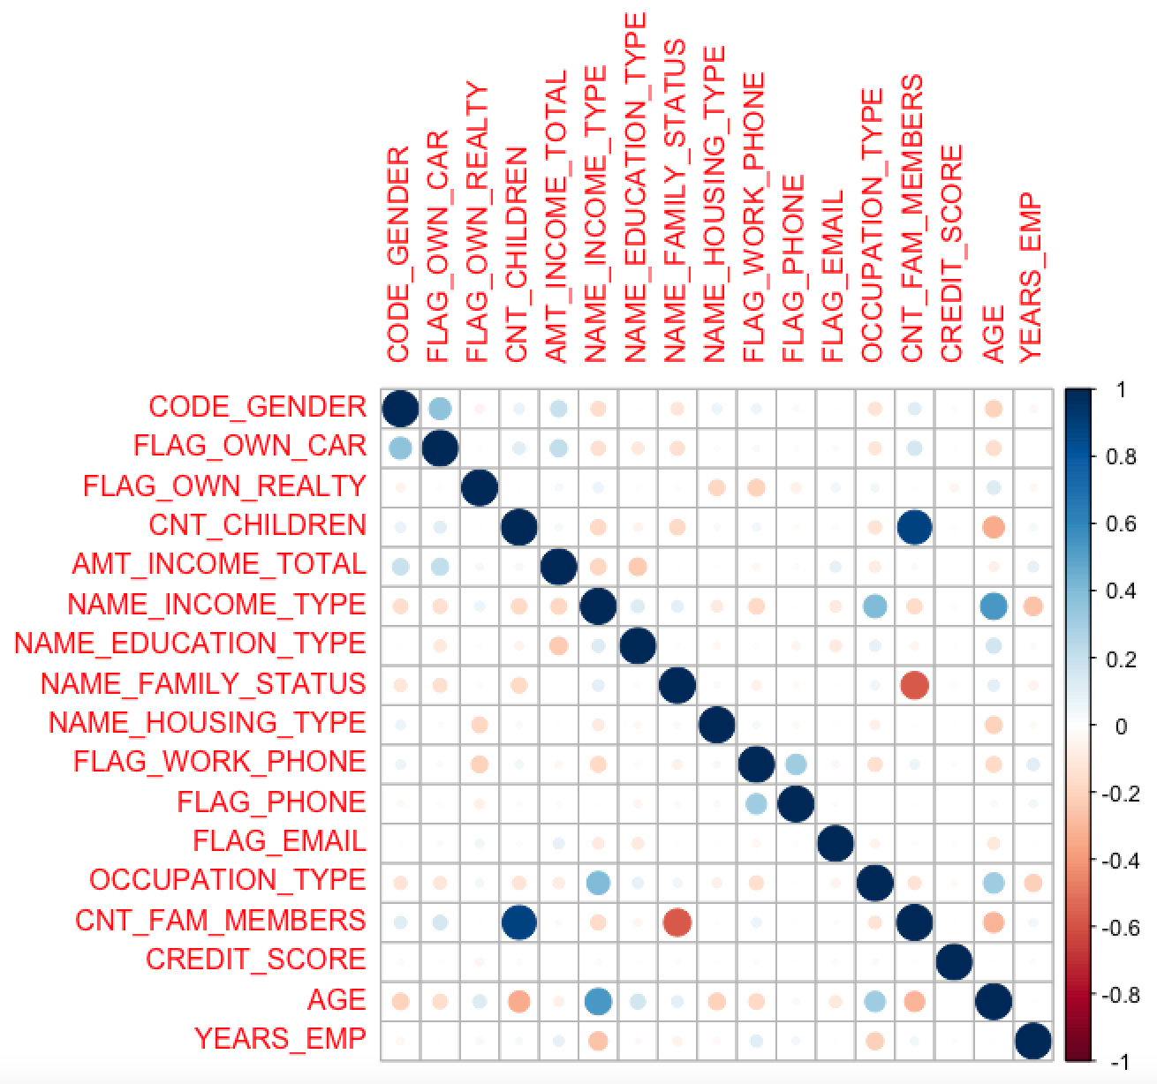
Correlation
CNT_FAM_MEMBERS is removed as it is positively correlated with CNT_CHILDREN
NAME_INCOME_TYPE has been removed as it has multicollinearity with AGE and OCCUPATION_TYPE.
FLAG_OWN_CAR has been removed as it has multicollinearity with CODE_GENDER.
The feature CREDIT_SCORE has been removed as the target variable and CREDIT_STATUS has been created from the Credit Scores.

Slide 6
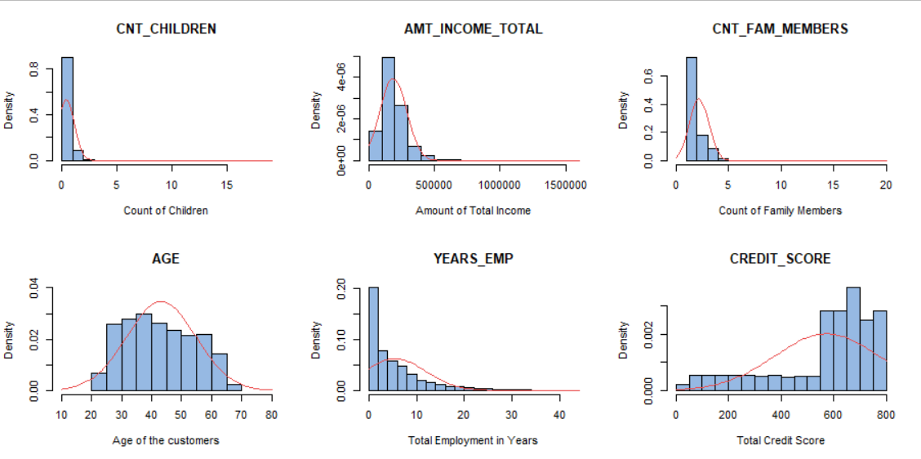
Histogram of Continuous Fields

Slide 7
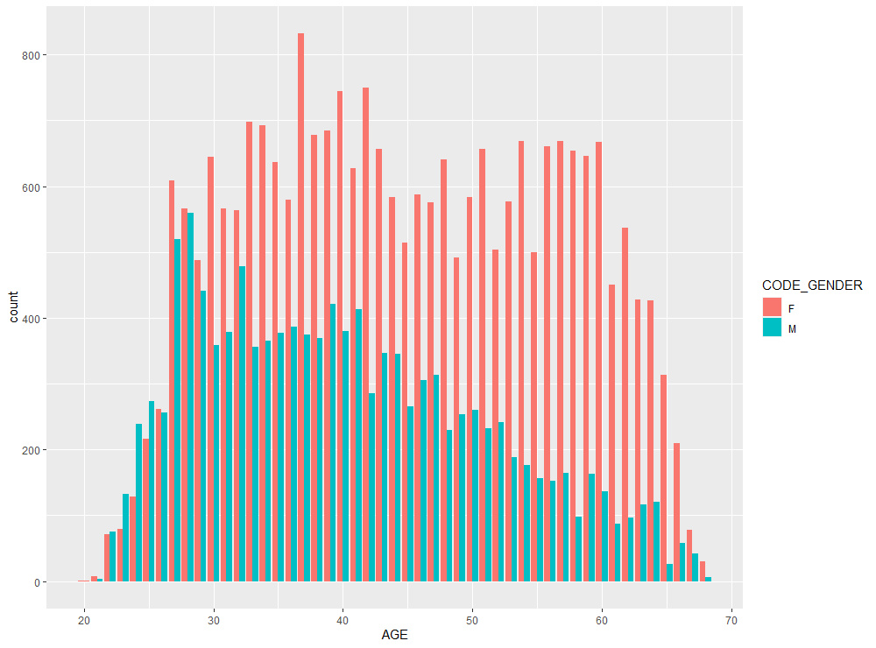
Data Visualisation

Slide 8
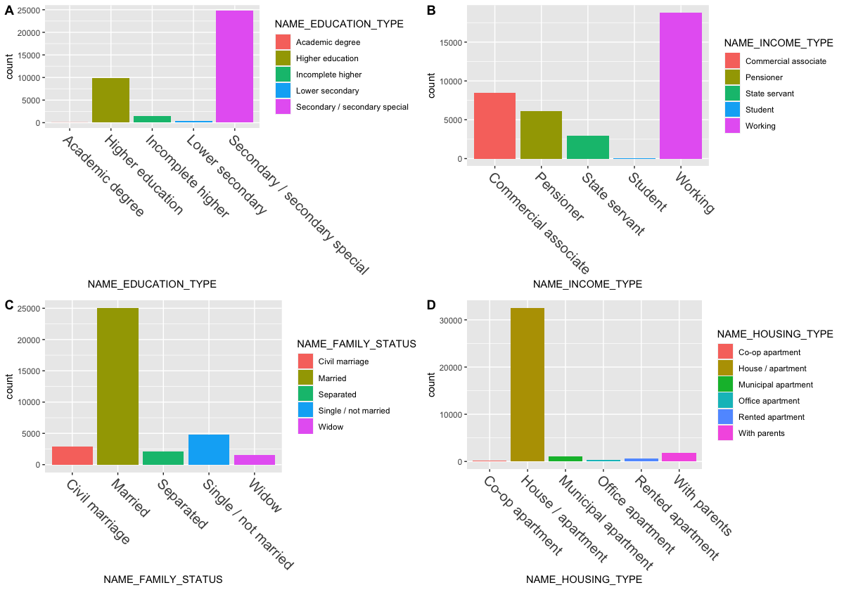
Various Factors

Slide 9
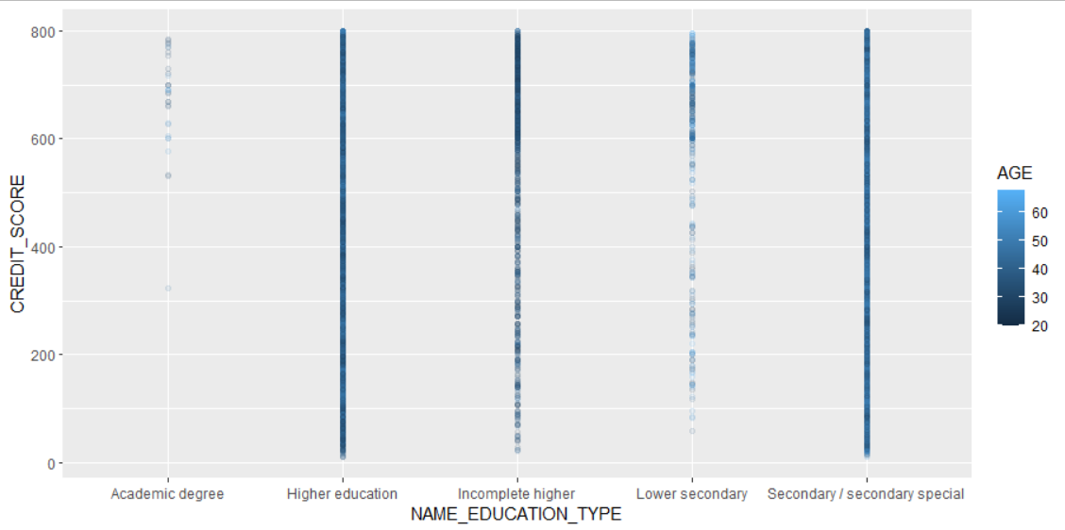
Scatter Plot

Slide 10
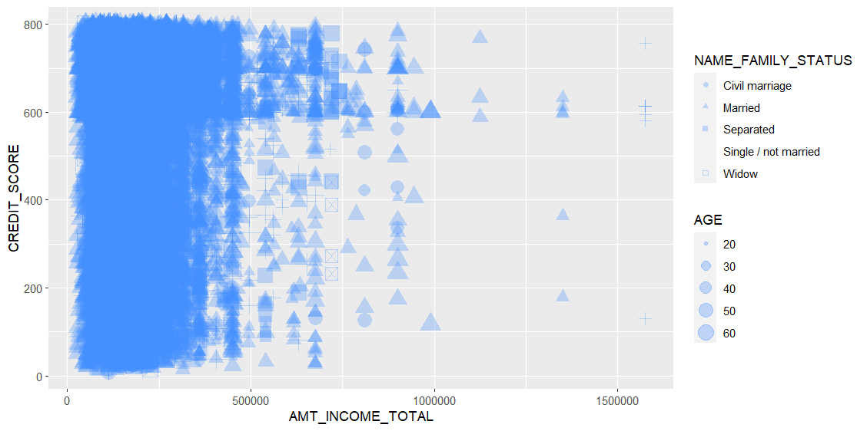
Scatter plot combining various factors

Slide 11
Data Insights
Female customers are twice as much as the male customers
Customers with academic degrees usually maintain high credit scores
Separated or widowed customers have income less than 750000
Majority of the customers are labourers

Slide 12
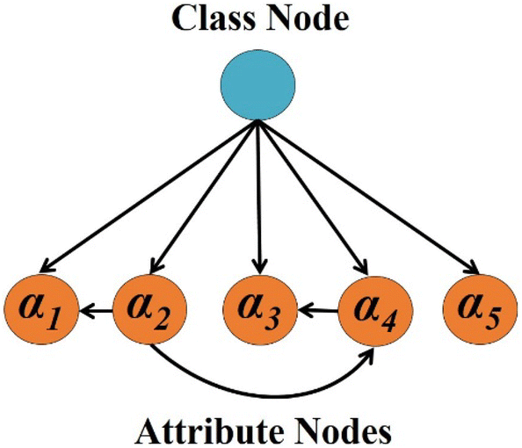
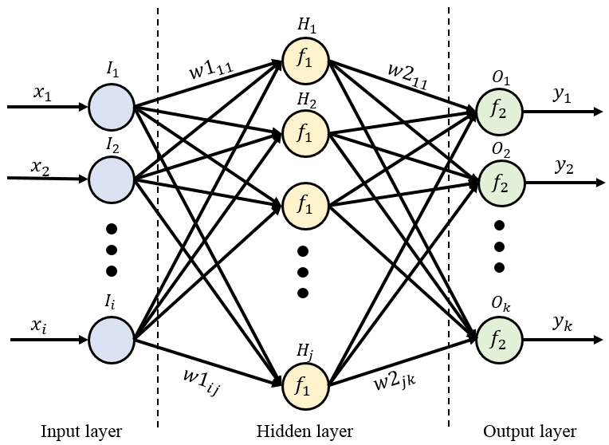
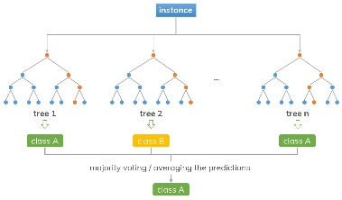
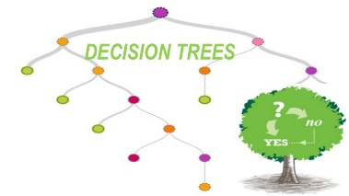
ML Algorithms
Naïve Bayes
Neural Network
Random Forest
Decision Tree
Accuracy: 71.39%
Accuracy: 30.60%
Accuracy: 71.34%
Accuracy: 69.60%

Slide 13
The Best Model
Models | Accuracy | Sensitivity | Specificity
C5 Decision tree
70:30 | 69.6% | 98.3% | 2.05%
80:20 | 69% | 97.51% | 3.92%
90:10 | 69.56% | 95.84% | 4.11%
Random Forest
70:30 | 70.16% | 99.96% | 0.03%
80:20 | 69.4% | 99.74% | 0.13%
90:10 | 71.34% | 100% | 0%
Naïve Bayes
70:30 | 70.23% | 99.97% | 0.24%
80:20 | 69.57% | 100% | 0%
90:10 | 71.39% | 99.84% | 0.57%
Neural Network
70:30 | 29.9% | 0.28% | 99.57%
80:20 | 30.6% | 0.33% | 99.68%
90:10 | 28.66% | 0.15% | 99.61%

Slide 14
Conclusion
Defaulters
Good Customers
Bad Customers

Slide 15

Thank You!

